Slide 1
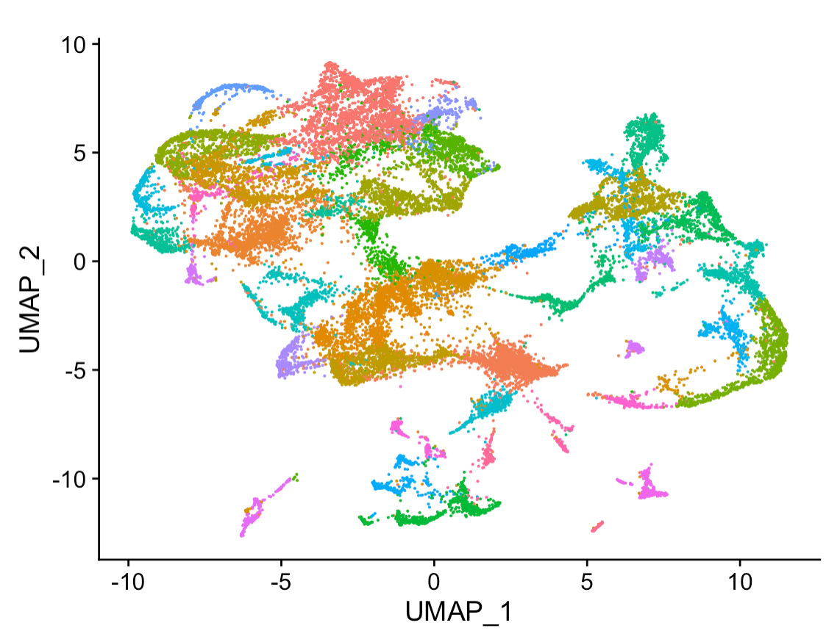
Un-supervised Learning NetNeuro 2023

Slide 2
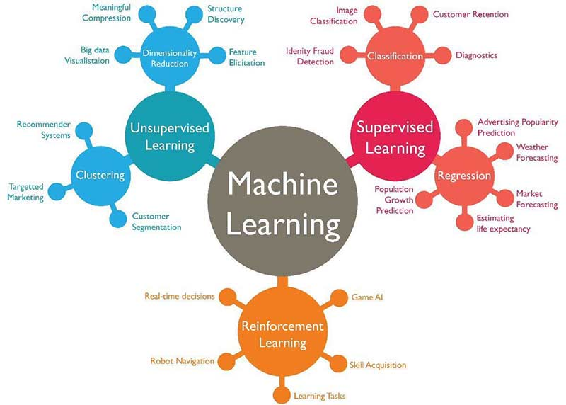

Slide 3
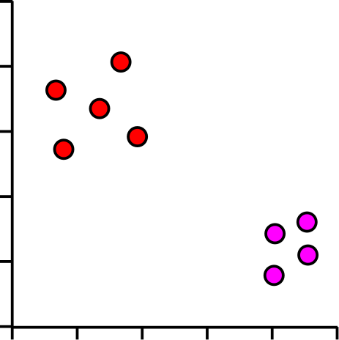
Example Dimensionality Reduction
Gene | Description | Cell 1 | Cell 2 | Cell 3 | Cell 4 | Cell 5
Inpp5d | inositol polyphosphate-5-phosphatase D | 7.00 | 5.45 | 5.89 | 6.03 | 5.75
Aim2 | absent in melanoma 2 | 3.01 | 4.37 | 4.59 | 4.38 | 4.18
Gldn | gliomedin | 3.48 | 3.63 | 4.61 | 4.70 | 4.74
Frem2 | Fras1 related extracellular matrix protein 2 | 4.75 | 4.66 | 3.46 | 3.74 | 3.45
Rps3a1 | ribosomal protein S3A1 | 6.10 | 7.23 | 7.44 | 7.36 | 7.34
Slc38a3 | solute carrier family 38, member 3 | 1.90 | 3.16 | 3.52 | 3.61 | 3.19
Mt1 | metallothionein 1 | 5.07 | 6.49 | 6.46 | 6.04 | 6.05
C1s1 | complement component 1, s subcomponent 1 | 2.74 | 3.02 | 3.86 | 4.10 | 4.10
Cds1 | CDP-diacylglycerol synthase 1 | 4.55 | 4.22 | 3.80 | 3.16 | 3.12
Ifi44 | interferon-induced protein 44 | 4.82 | 4.52 | 3.87 | 3.42 | 3.59
Lefty2 | left-right determination factor 2 | 6.95 | 6.28 | 5.88 | 5.60 | 5.61
Fmr1nb | fragile X mental retardation 1 neighbor | 4.28 | 2.78 | 3.10 | 3.25 | 2.57
Tagln | transgelin | 7.93 | 7.91 | 7.20 | 7.02 | 6.68
What you have is a lot of features
What you want is a few features you can look at
Keep only the important information
What counts as important?

Slide 4
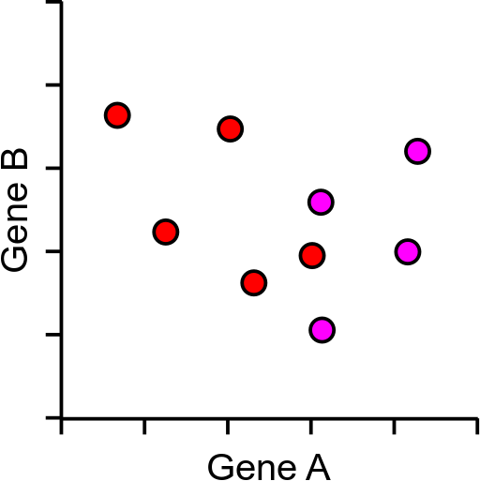
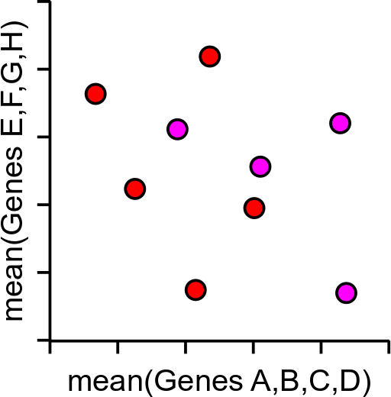
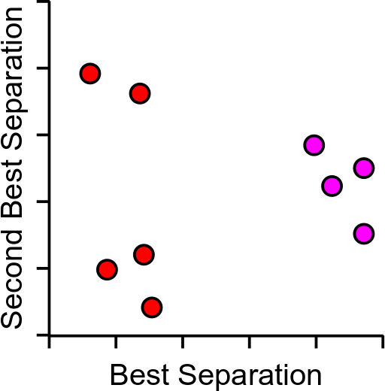
Example Too Much Data
5000 cells and 2500 measured genes
Realistically we can plot 2 dimensions (x,y)

Slide 5
Principal Components Analysis (PCA)
Method to optimally summarise large multi-dimensional datasets
Can find a smaller number of dimensions (ideally 2) which retain most of the useful information in the data
Builds a Linear recipe for converting large amounts of data into new more useful features, called a Principle Component (PC), eg:
PC = (GeneA*10)+(GeneB*3)+(GeneC*-4)+(GeneD*-20)…

Slide 6
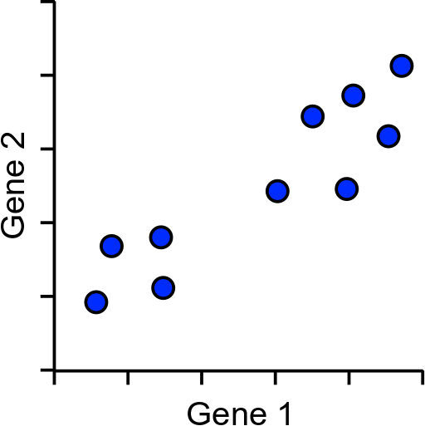
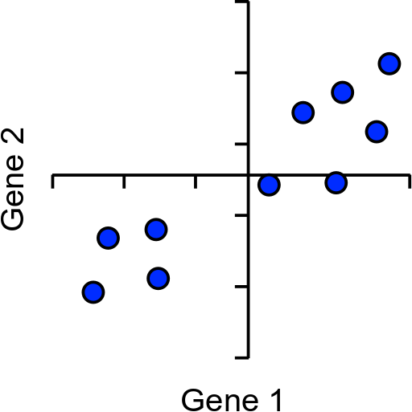
How does PCA work?
Simple example using 2 genes and 10 cells

Slide 7
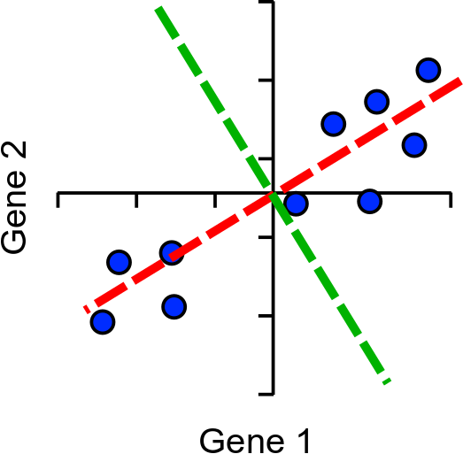
Explaining Variance
Project onto PC
Calculate sum of squared differences (SSD)
This is a measure of variance called the ‘eigenvalue’
Divide by (points-1) to get actual variance
This works in many dimensions

Slide 8
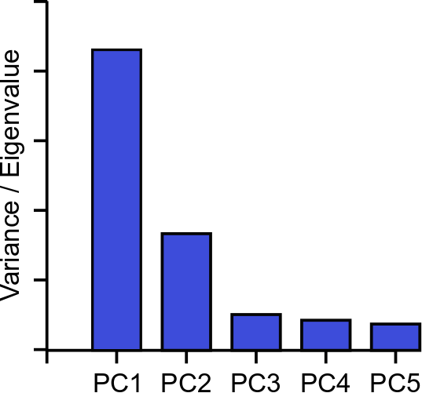
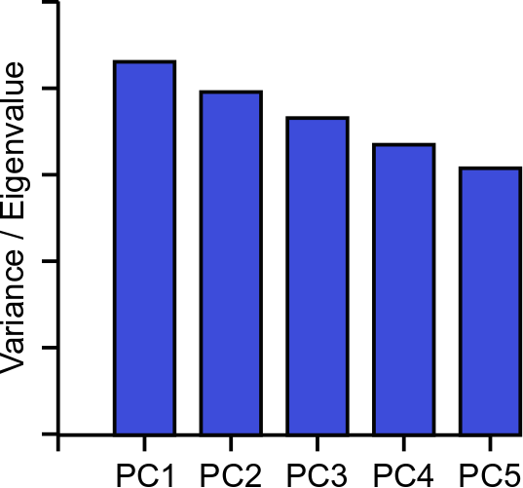
Explaining Variance – Scree Plots

Slide 9
Normalization
Technique to force the attributes to have a common value range
Why is the needed ? (Depends on what you think is important)
Consider the following pair of data points
x_{i}: (0.1, 20) and x_{j}: (0.9, 720).
dist(x_{i} , x _{j} ) = (0.9 − 0.1)² + (720− 20)² = 700.000457
Two main approaches to standardize interval scaled attributes, range and z-score. f is an attribute
^{x}if
min( f )
range(x ) =
,
if
max( f ) − min( f )

Slide 10
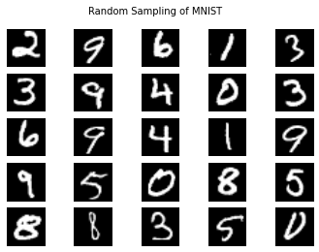
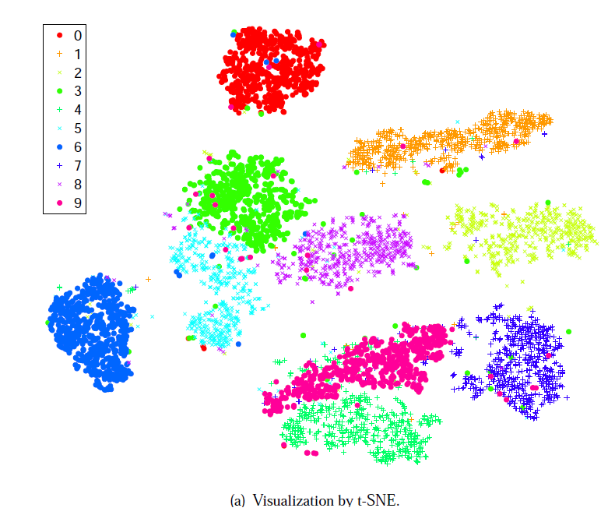
Problem: What if I have more than two really important PCA values
How can humans visualize high-dimensional data?
images (pixels can be considered dimensions)
single cell nuclei is described by 30 variables (variables = dimensions)
Specifically ...
How to visualize in 2D or 3D space?
to see relationships
check if features are separating the data
http://arxiv.org/pdf/1310.1531.pdf

Slide 11
What is t-SNE?
t-Distributed Stochastic Neighbor Embedding (t-SNE)
Models the probabilities that high-d points xi,xj are neighbors
Models the probabilities the corresponding low-d
points yi,yj are neighbors
Finds a low-d representation that is faithful to the high-d model

Slide 12
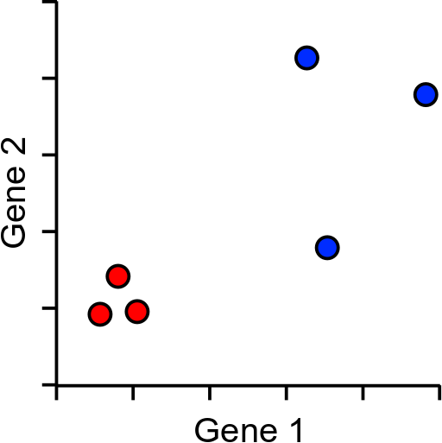
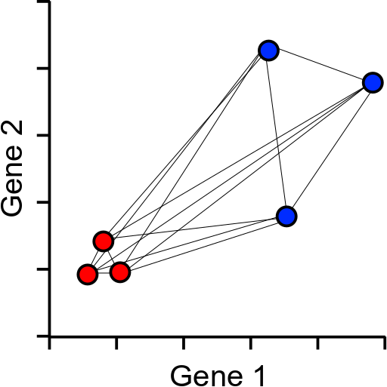
How does tSNE work?
Based around all-vs-all table of pairwise cell to cell distances

Slide 13
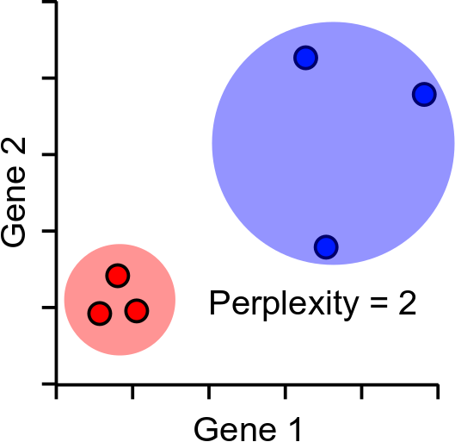
Distance scaling and perplexity
Perplexity = expected number of neighbours within a cluster
Distances scaled relative to perplexity neighbours
The performance of TSNE is fairly robust to changes in the perplexity, and typical values are between 5 and 50

Slide 14
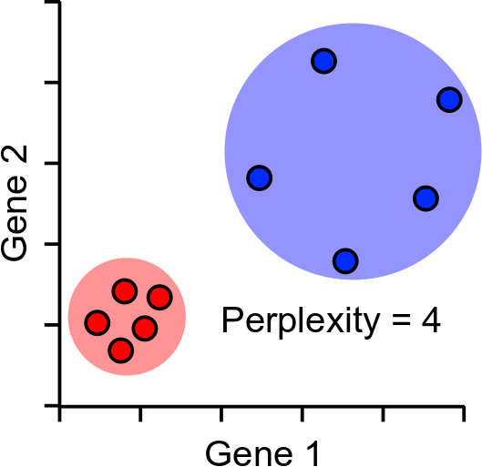
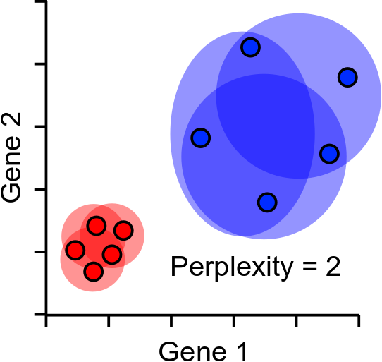
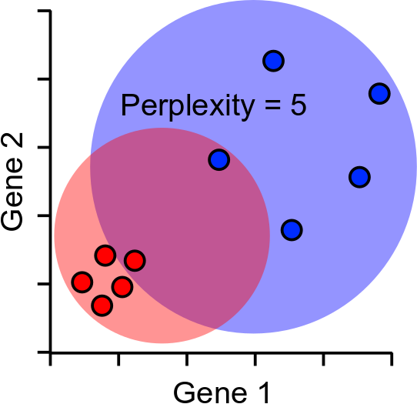
Perplexity Robustness

Slide 15
tSNE Projection
Normally projects in 2D, but can be any number of dimensions
Randomly scatter all points within the space
Start a simulation
Aim is to make the point distances match the distance matrix
Shuffle points based on how well they match
Stop after fixed number of iterations, or
Stop after distances have converged

Slide 16
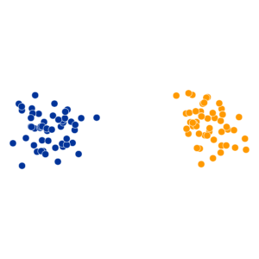
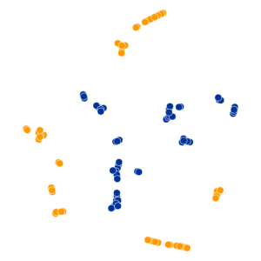
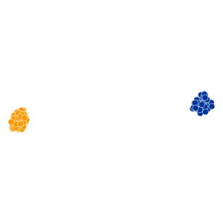
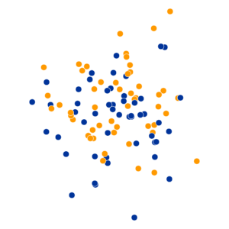
tSNE Practical Examples
Perplexity Settings Matter
Original
Perplexity = 2
Perplexity = 30
Perplexity = 100
https://distill.pub/2016/misread-tsne/

Slide 17
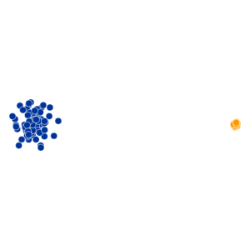
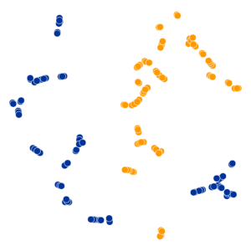
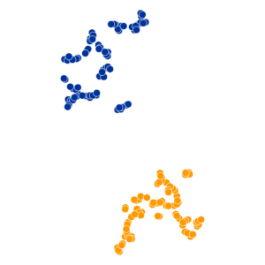
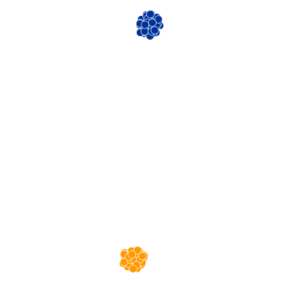
tSNE Practical Examples
Cluster Sizes are Meaningless
Perplexity = 2
Perplexity = 5
Perplexity = 50
https://distill.pub/2016/misread-tsne/

Slide 18
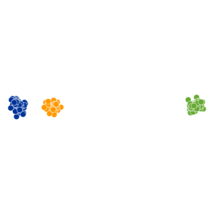
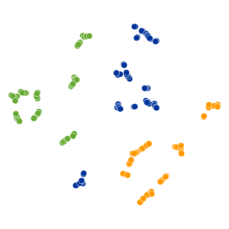
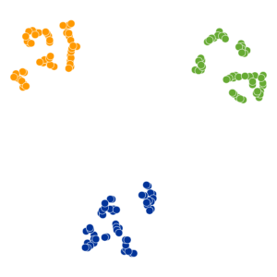
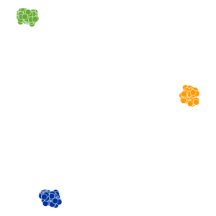
tSNE Practical Examples
Distances between clusters can’t be trusted
Perplexity = 2
Perplexity = 5
Perplexity = 30
https://distill.pub/2016/misread-tsne/

Slide 19
UMAP
UMAP is a replacement for tSNE to fulfil the same role
Conceptually very similar to tSNE, but with a couple of relevant (and somewhat technical) changes
Practical outcome is:
UMAP is quite a bit quicker than tSNE
UMAP can preserve more global structure than tSNE*
UMAP can run on raw data without PCA preprocessing*
UMAP can allow new data to be added to an existing projection
* In theory, but possibly not in practice

Slide 20
UMAP differences
Instead of the single perplexity value in tSNE, UMAP defines
Nearest neighbours: the number of expected nearest neighbours – basically the same concept as perplexity
Minimum distance: how tightly UMAP packs points which are close together
Nearest neighbours will affect the influence given to global vs local information.
Min dist will affect how compactly packed the local parts of the plot are.

Slide 21
Reminder Dimensionality Reduction
Picture of a Line (500x500 pixels=250,000 Numbers)
Equation: y=m*x+b (2 numbers)
Both have the same information in different formats
It’s often a lot easier to analyze 2 number than 250,000

Slide 22
A Reminder
PCA
Linear algorithm that finds the directions with the largest variance
You can trust inter and intra cluster distances
You may have more important PCA components than you want to plot
Lossless until you discard higher PC dimensions
TSNE/UMAP
Relies on nearest-neighbors information
You can not trust inter and intra cluster distances
You can pick the dimension size you want to reduce to use
What if you want to get the best of both worlds
What if you want to use un-structured data

Slide 23
Deep Unsupervised Learning Vocab
Deep learning uses stack of layers to approximate a function. In unsupervised learning that function is a mapping from your input data to a latent space
Latent space – often denoted z (like x denotes inputs), think of this like your principal components or outputs of UMAP it’s then transformed space that normally has a lower dimension than the original.
Encoder – A function that maps x -> z it ‘encodes’ your input data
Decoder – A function that maps z -> x it ‘decodes’ your input data
Algorithms may use some variations one or all of these

Slide 24
Autoencoder
A common deep learning model for dimensionality reduction
Input
Reconstruction
Encoder
Decoder
Z
Trained to find the best way to ‘compress’ all the information into z possible to recreate the original data
The encoder preforms some dimensionality reduction, and the decoder tries to reverse this process

Slide 25
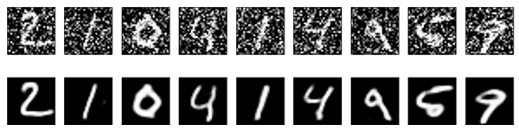
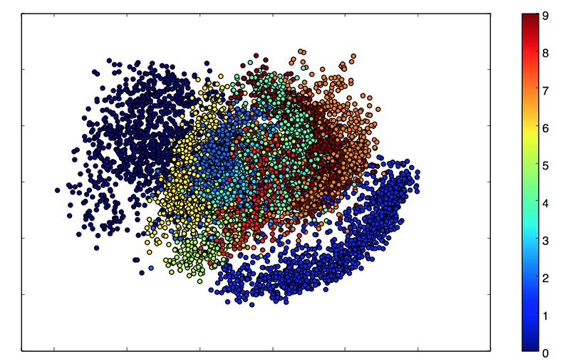
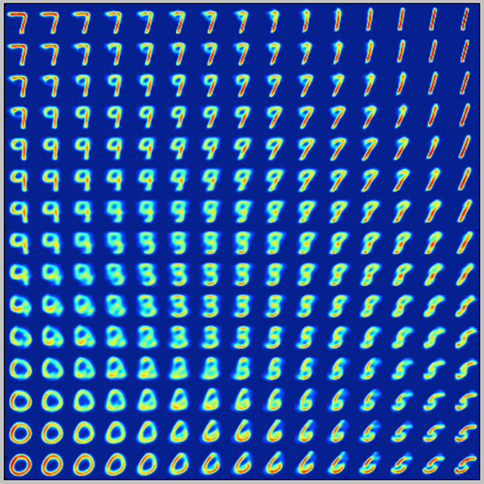
Encoder
Decoder
Latent Space
https://blog.keras.io/building-autoencoders-in-keras.html

Slide 26
Denoising
Another handy feature of Autoencoders is their ability to denoise
Noisy
Reconstructed
True

Slide 27
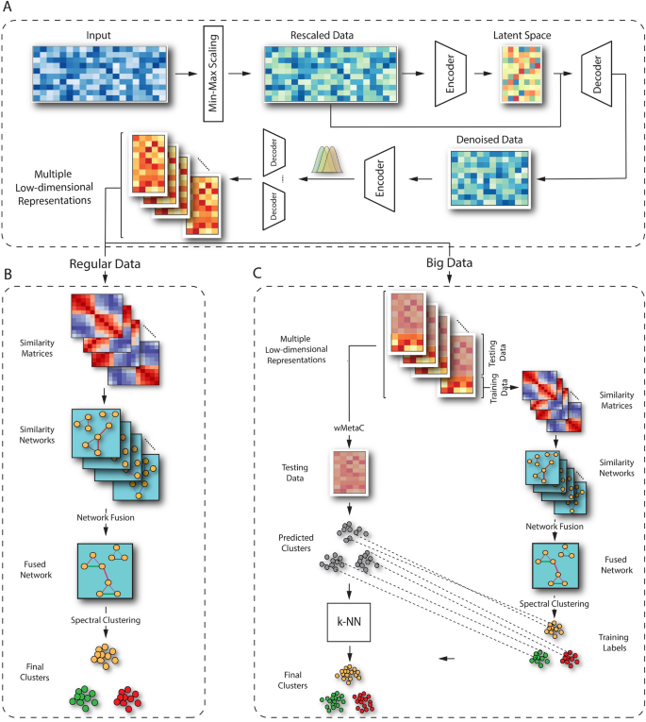
Becoming Available as Tools in Genomics
https://www.nature.com/articles/s41598-022-14218-6
scCAN: single-cell clustering using autoencoder and network fusion
Lots of exploration in this space, so there are lots of new algorithms to try, this one has a convenient R package

Slide 28
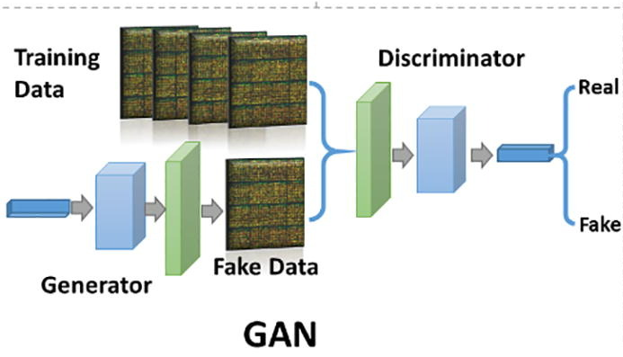
Generative Adversarial Learning (GANS)
A different model with only a generator, its goal is to generate new examples that have the same properties as your data.
Usually Better reconstructions that auto-encoders
Usually worse latent spaces
Application lean toward generating new examples
Therapeutic Proteins
Genomes
Etc.
Example https://thisstartupdoesnotexist.com/
https://www.sciencedirect.com/science/article/pii/S2001037020303068

Slide 29
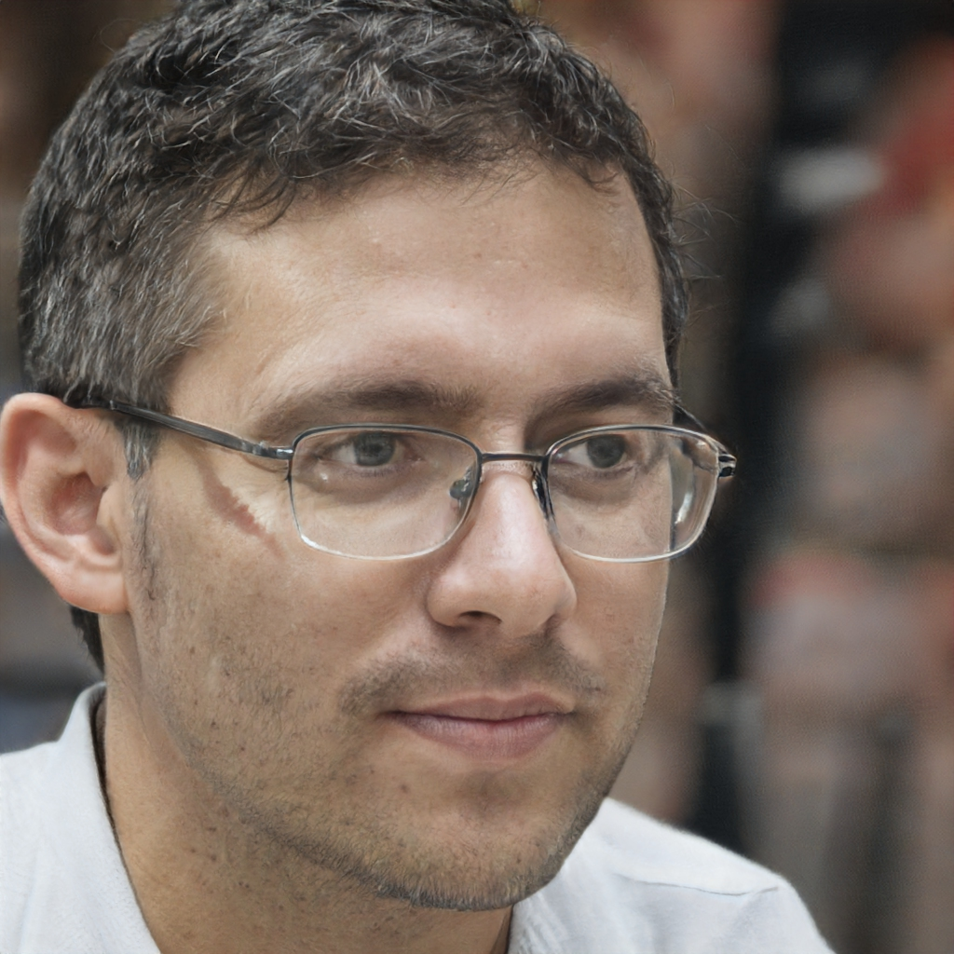
These Networks have produced incredible results for images
https://thispersondoesnotexist.com/

Slide 30
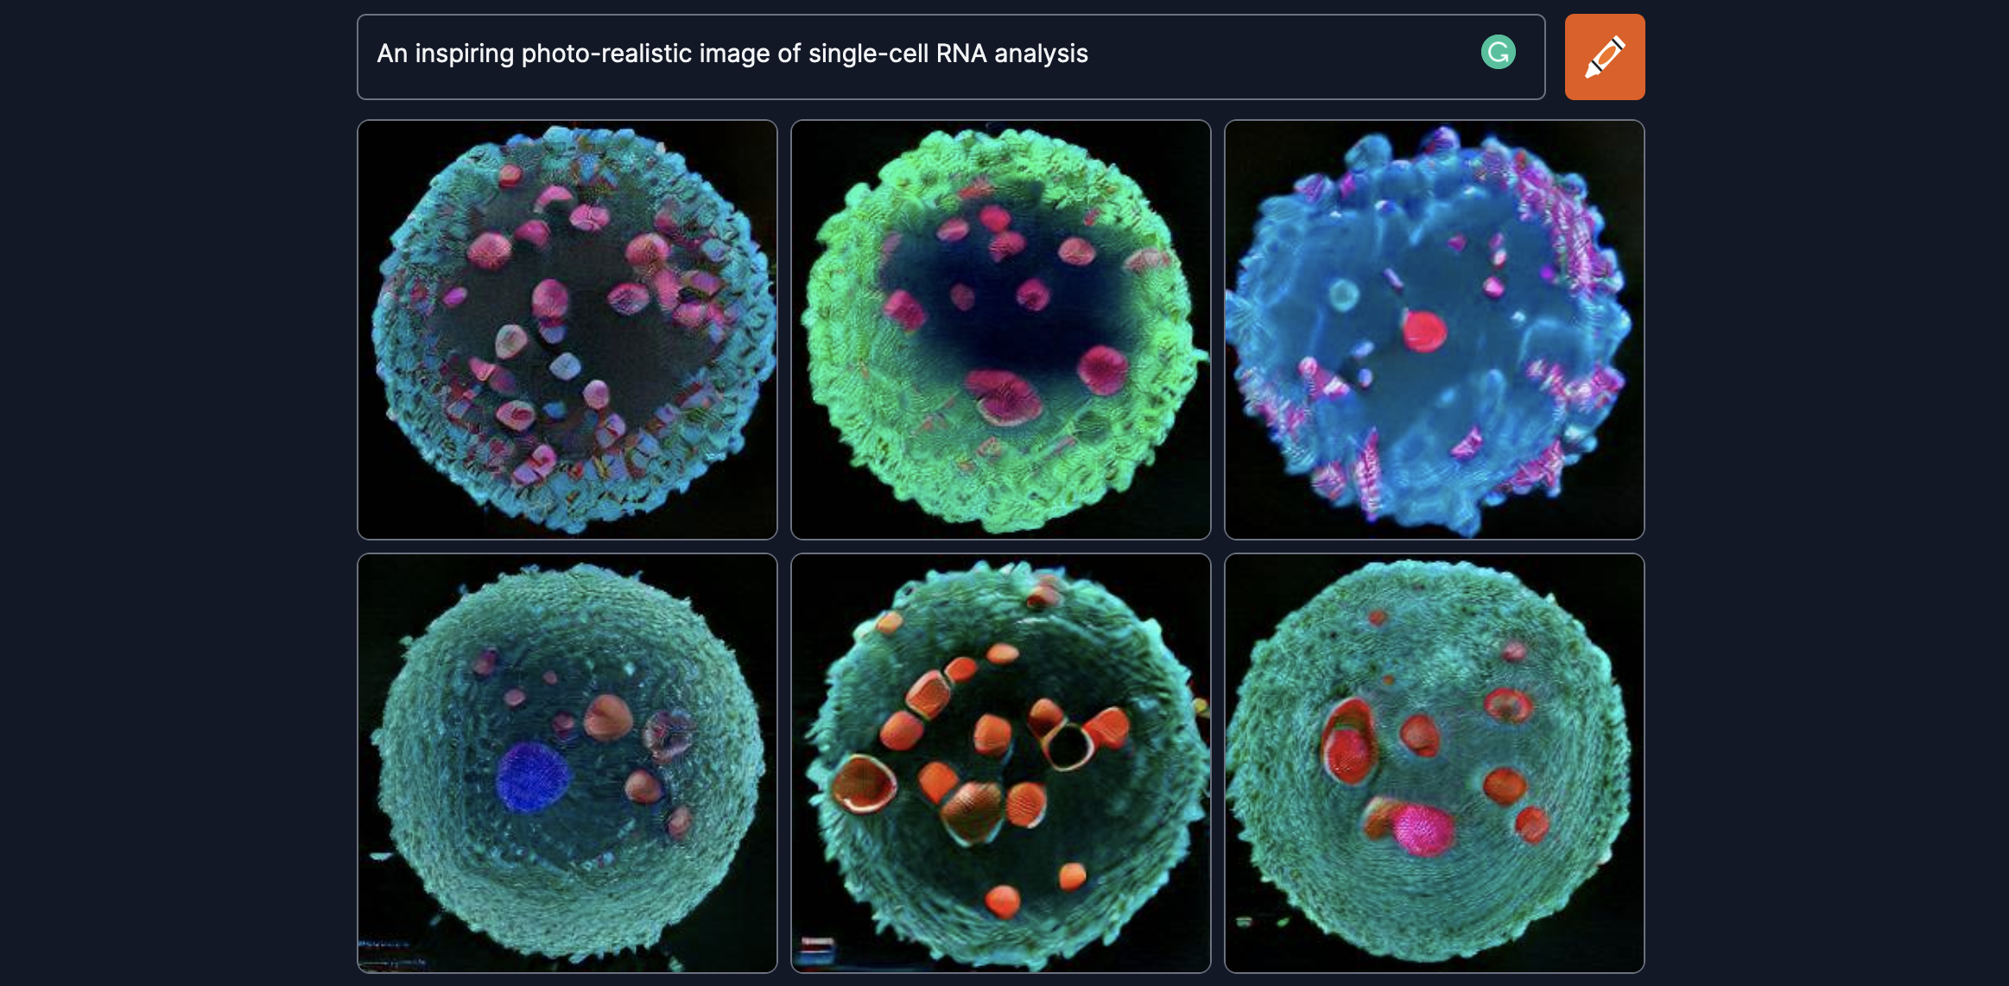
https://www.craiyon.com/

Slide 31

Other Models
https://lilianweng.github.io/posts/2021-07-11-diffusion-models/

Slide 32
Clustering

Slide 33
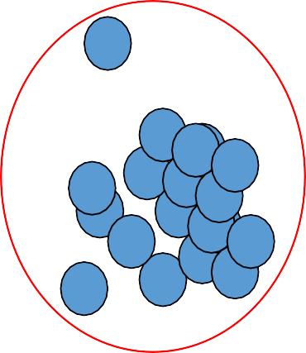
Clustering Motivation
The goal of clustering is to
group data points that are close (or similar) to each other
identify such groupings (or clusters) in an unsupervised manner
How to define similarity ?
How many iterations for checking cluster quality ?

Slide 34

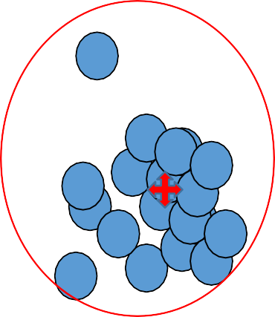
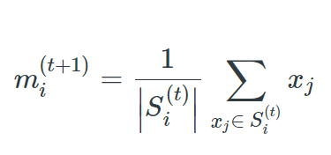
Cluster
A cluster is represented by a single point, known as centroid (or cluster center) of the cluster.
Centroid is computed as the mean of all data points in a cluster
Cluster boundary is decided by the farthest data point in the cluster.

Slide 35
Applications
Example 1: groups people of similar sizes together to make “small”, “medium” and “large” T-Shirts.
Tailor-made for each person: too expensive
One-size-fits-all: does not fit all.
Example 2: In marketing, segment customers according to their similarities
To do targeted marketing.
Example 3: Given a collection of text documents, we want to organize them according to their content similarities,
To produce a topic hierarchy

Slide 36
Types of clustering
Clustering: Task of grouping a set of data points such that data points in the same group are more similar to each other than data points in another group (group is known as cluster)
it groups data instances that are similar to (near) each other in one cluster and data
instances that are very different (far away) from each other into different clusters.
Types:
Exclusive Clustering: K-means
Overlapping Clustering: Fuzzy C-means
Hierarchical Clustering: Agglomerative clustering, divisive clustering

Slide 37
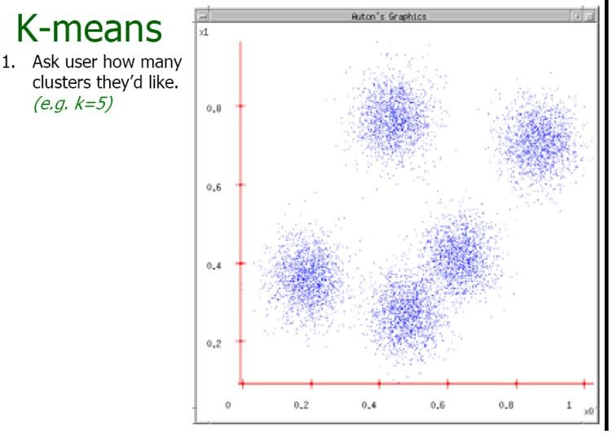
K-means example
This slide is taken from: Andrew Moore

Slide 38
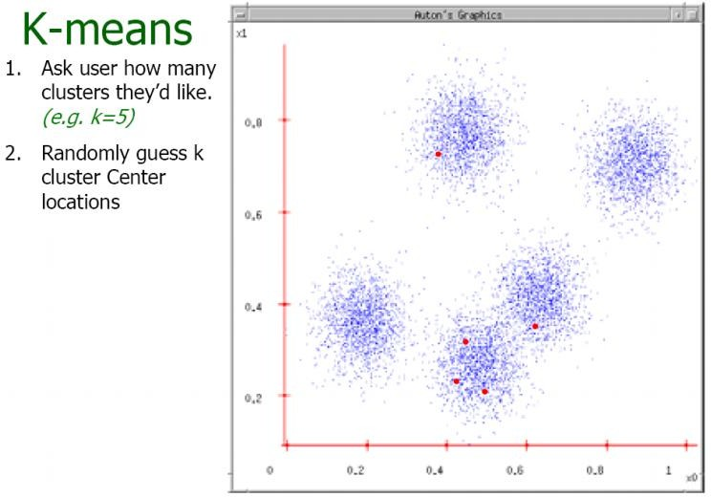
Example contd..
This slide is taken from: Andrew Moore

Slide 39
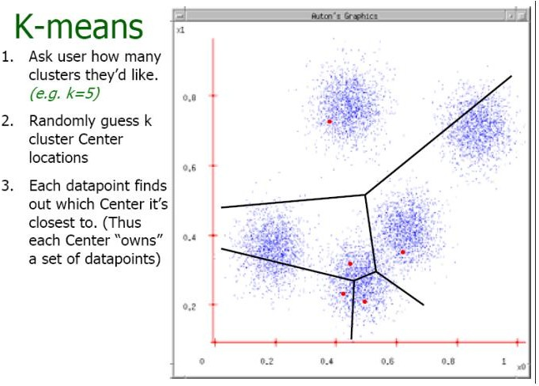
Example contd..
This slide is taken from: Andrew Moore

Slide 40
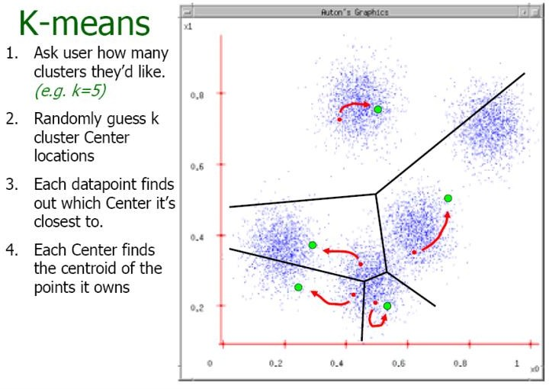
Example contd..
This slide is taken from: Andrew Moore

Slide 41
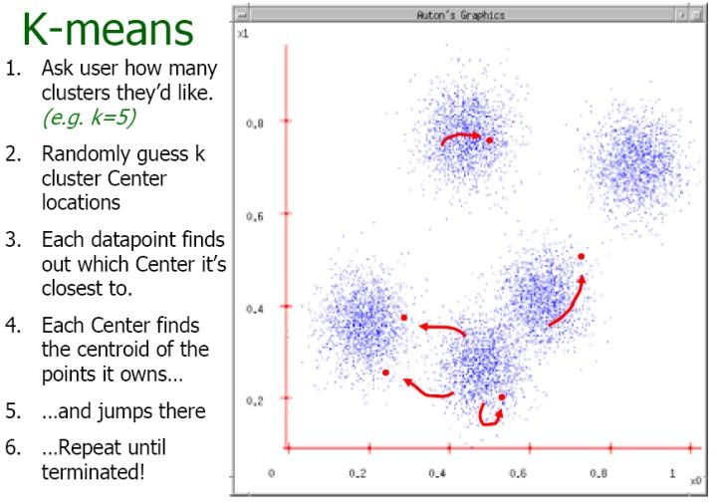
Example contd..
This slide is taken from: Andrew Moore

Slide 42
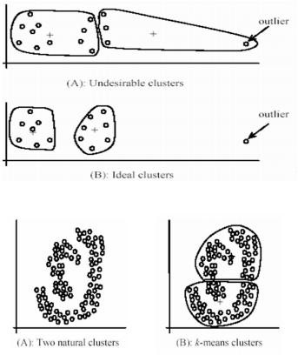
Contd..
Pros
Simple, fast to compute
Converges to local minimum of within-cluster squared error
Cons
Setting k? (Can be done with a scree plot)
Sensitive to initial centers
Sensitive to outliers
Detects spherical clusters
Assuming means can be computed
Image source: Google

Slide 43
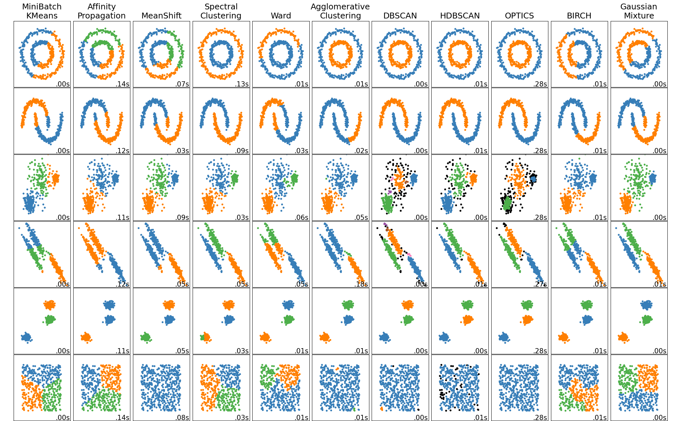
Clustering Examples (https://scikit-learn.org/stable/modules/clustering.html)

Slide 44
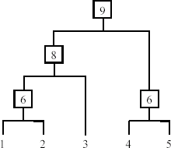
3. Hierarchical Clustering
Produce a nested sequence of clusters, a tree, also called Dendrogram.

Slide 45
Types of hierarchical clustering
Agglomerative (bottom up) clustering: It builds the dendrogram (tree) from the bottom level, and
merges the most similar (or nearest) pair of clusters
stops when all the data points are merged into a single cluster (i.e., the
root cluster).
Divisive (top down) clustering: It starts with all data points in one cluster, the root.
Splits the root into a set of child clusters. Each child cluster is recursively divided further
stops when only singleton clusters of individual data points remain, i.e.,
each cluster with only a single point
This slide is taken from Bing Liu, UIC
23

Slide 46
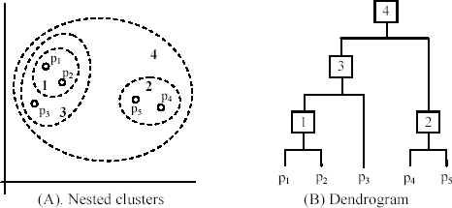
An example: working of the algorithm
This slide is taken from Bing Liu, UIC
25

Slide 47
How to choose a clustering algorithm
A vast collection of algorithms are available. Which one to choose for our problem ?
Choosing the “best” algorithm is a challenge.
Every algorithm has limitations and works well with certain data distributions.
It is very hard, if not impossible, to know what distribution the application data follow. The data may not fully follow any “ideal” structure or distribution required by the algorithms.
One also needs to decide how to standardize the data, to choose a suitable distance function and to select other parameter values.

Slide 48
Contd..
Due to these complexities, the common practice is to
run several algorithms using different distance functions and parameter settings, and
then carefully analyze and compare the results.
The interpretation of the results must be based on insight into the meaning of the original data together with knowledge of the algorithms used.
Clustering is highly application dependent and to certain extent subjective (personal preferences).

Slide 49
Summary
Unsupervised learning helps handle large unlabeled datasets
Can be used with Deep Learning for un-structured data
Types of clustering dimensionality reduction:
K-means, hierarchical, PCA, t-SNE, UMAP
Similarity functions:
Euclidean distance, Manhattan distance
Stopping criteria:
SSD
Which algorithm to choose

